Slide 1



Sustainable Supply Chain
Dashboard

Slide 2

Learning Objectives
Sustainability in supply chains and the importance of data-driven insights for decision-making.
Learn how to clean, transform, and visualize data using Power BI for supply chain analytics.
Key performance indicators like revenue, cost, lead time, defect rate, and transportation efficiency must be identified.
Develop an interactive Power BI dashboard to track supply chain sustainability metrics.
Use DAX formulas and Power Query transformations to analyze and optimize operations.
GOAL

Slide 3
Tools and Technology used
Power BI: Uses to visualize data, model, and interactive dashboards.
Power Query: For data cleaning, transformation, and integration.
DAX, or Data Analysis Expressions: Used for calculated columns and measures.
CSV Data: Includes information about products, suppliers, revenues, costs, transportation, and defect rates.
Cloud or Local Storage: Data can be stored and updated via Excel, databases, or APIs.

Slide 4
Methodology
Data Collection: Import CSV dataset into Power BI.
Data Cleaning & Transformation: Treat missing values, duplicates, and correct data types. Create new metrics like Sustainability Score
Data Modeling: Establish relationships between tables (e.g., supplier, transportation, product sales). Calculate measures using DAX.
Dashboard Creation: Interactive visuals: KPIs, charts, maps, tables. Filters and slicers for dynamic analysis
Insights & Optimization: Trend analysis and recommendations based on data.

Slide 5
Problem Statement:
Supply chains are still facing challenges towards sustainability, cost management, and efficiency.
High lead times, transportation emissions, and defect rates impact profitability and environmental responsibility.
Lack of visibility in real-time over supplier performance and logistics.
Manual tracking of supply chain metrics is inefficient and error-prone.
Need for a data-driven approach to measure and improve sustainability performance.

Slide 6
Solution:
Real-time monitoring of the performance of a supply chain with the help of a Power BI dashboard.
Tracking of KPI: Total revenue, costs, defect rates, and lead times.
Interactive charts: Bar Chart: Revenue by type of product, Line Chart: Lead time versus defect rate, Pie Chart: Transportation mode analysis, Map: Supplier location and efficiency
Filters & Slicers to go deep in insights
Outcome: Enhanced decision-making, reduction in costs, and sustainability.

Slide 7
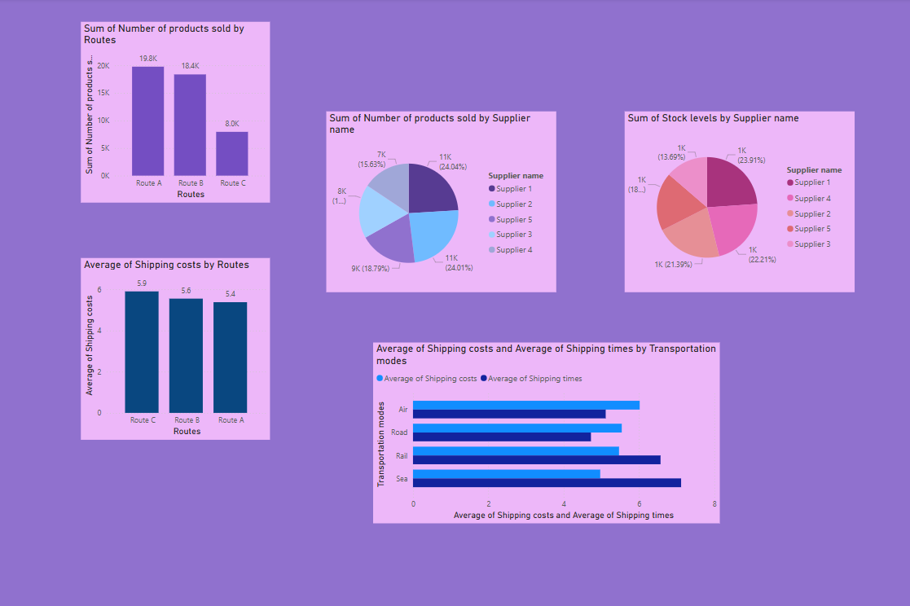
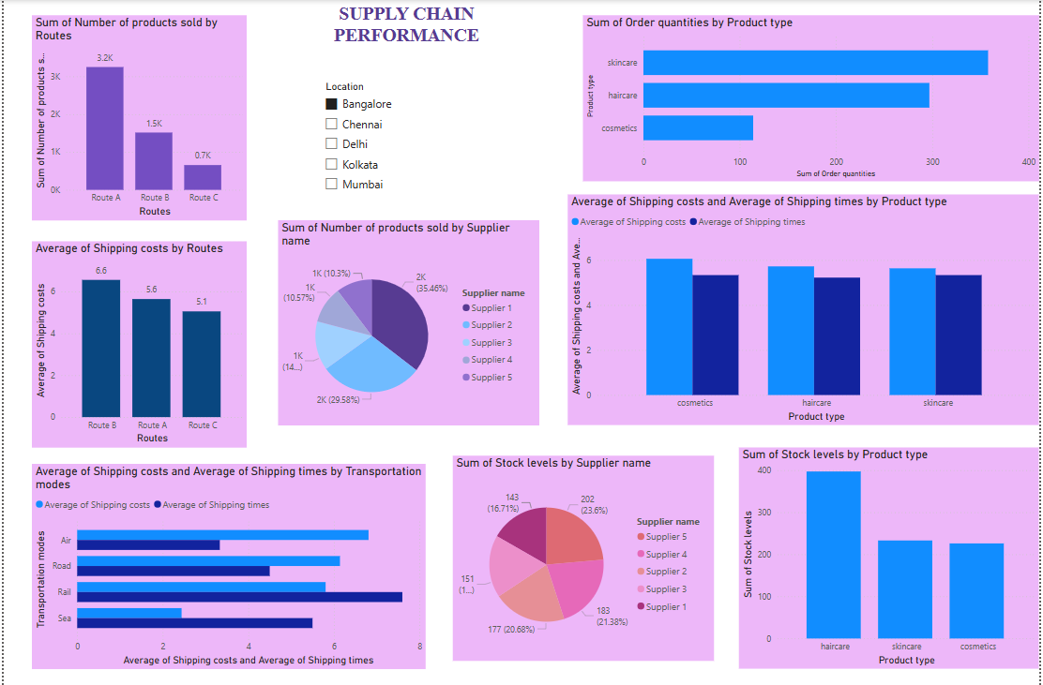
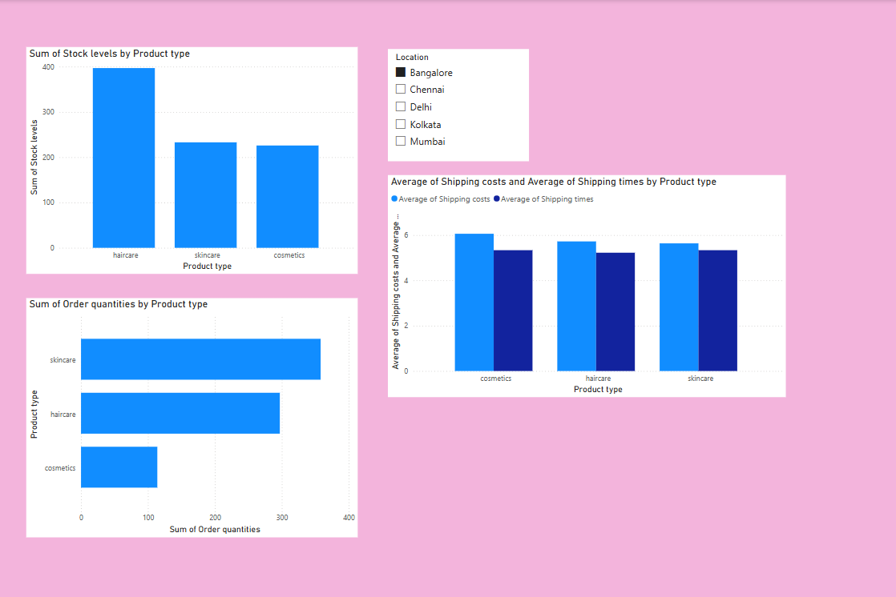
Screenshot of Output:

Slide 8
Conclusion:
Power BI helps in data-driven supply chain optimization.
These insights are useful for cutting costs, efficiency, and sustainability.
Automated dashboards provide real-time monitoring for effective supplier and logistics management.
This project shows how analytics can be used to reach sustainable supply chain goals.
Future scope: Integration of predictive analytics, AI, and real-time IoT data.

